Slide 1
A comparison of fixed and random effects using Stata

Slide 2
Adapted example from Rabe-Hesketh and Skrondal (2008) model of wages

Slide 3
Stata
xtreg lwage black hisp union married exper yeart educt, i(nr) fe
est store fixed
xtreg lwage black hisp union married exper yeart educt, i(nr) re
est store random
Hausman fixed random
  Hausman: Tests the hypothesis that the FE coefficients are identical to the RE

Slide 4
 | FE | RE
 | lwage | lwage
black |  | -0.134***
 |  | (0.048)
hisp |  | 0.017
 |  | (0.043)
union | 0.084*** | 0.111***
 | (0.019) | (0.018)
married | 0.061*** | 0.076***
 | (0.018) | (0.017)
experience | 0.060*** | 0.033***
 | (0.003) | (0.011)
year since 1980 |  | 0.026**
 |  | (0.011)
years in education from high school grad |  | 0.095***
 |  | (0.011)
_cons | 1.212*** | 1.317***
 | (0.017) | (0.037)
sigma_u | .40 | .32
sigma_e | .35 | .35
Rho | .57 | .45
Obs. | 4360 | 4360
Standard errors are in parenthesis
*** p<0.01, ** p<0.05, * p<0.1

Slide 5
Hausman

Slide 6
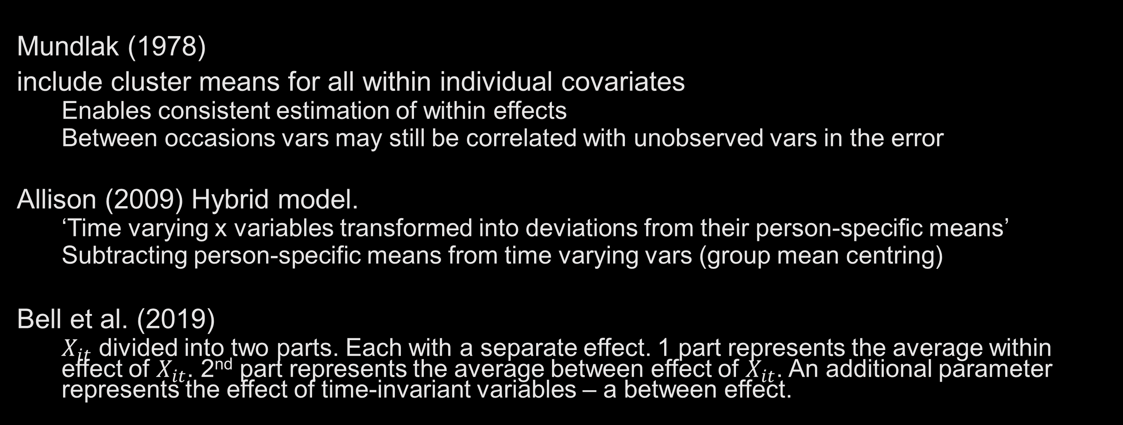
Alternatives
Mundlak (1978)
include cluster means for all within individual covariates
  Enables consistent estimation of within effects
  Between occasions vars may still be correlated with unobserved vars in the error
Allison (2009) Hybrid model.
  ‘Time varying x variables transformed into deviations from their person-specific means’
  Subtracting person-specific means from time varying vars (group mean centring)
Bell et al. (2019)
  $X_{it}$ divided into two parts. Each with a separate effect. 1 part represents the average within effect of $X_{it}$. 2nd part represents the average between effect of $X_{it}$. An additional parameter represents the effect of time-invariant variables – a between effect.

Slide 7
 | FE | RE | Mundlak
 | lwage | lwage | lwage
black |  | -0.134*** | -0.141***
 |  | (0.048) | (0.049)
hisp |  | 0.017 | 0.010
 |  | (0.043) | (0.042)
union | 0.084*** | 0.111*** | 0.084***
 | (0.019) | (0.018) | (0.019)
married | 0.061*** | 0.076*** | 0.061***
 | (0.018) | (0.017) | (0.018)
exper | 0.060*** | 0.033*** | 0.028**
 | (0.003) | (0.011) | (0.011)
yeart |  | 0.026** | 0.032***
 |  | (0.011) | (0.012)
educt |  | 0.095*** | 0.091***
 |  | (0.011) | (0.011)
mn_union |  |  | 0.175***
 |  |  | (0.050)
mn_married |  |  | 0.081*
 |  |  | (0.045)
_cons | 1.212*** | 1.317*** | 1.267***
 | (0.017) | (0.037) | (0.040)
sigma_u | .40 | .32 | .32
sigma_e | .35 | .35 | .35
rho | .57 | .46 | .46
Obs. | 4360 | 4360 | 4360
Standard errors are in parenthesis
*** p<0.01, ** p<0.05, * p<0.1

Slide 8
Which approach?
Classically, in econometrics the preference is for a FE approach,
E.g. Allison (2009)
  Individual-level variation is likely to be correlated with the unobserved characteristics of individuals
  Partialling out the contaminated variation produces approximately unbiased estimates
  Trade off efficiency for consistency
By contrast Bell et al. (2019) argue that:
  ‘A well-specified RE model provides everything that FE provides and more, making it the superior method’
  ‘FE models can say nothing about relationships with independent variables that do not change over time—only about deviations from the mean over time. FE models therefore “throw away important and useful information about the relation between the explanatory and the explained variables in a panel” (Nerlove 2005, p. 20).

Slide 9
Recommendations
Think about what you want to know, substantively
  Are you interested in the between effects or within and between associations?
  Are you interested in time invariant associations?
Sensitivity analysis
  Try differing specifications
  Report on alternative models
Ultimately, provide a robust and considered explanation for the approach you choose

Slide 10
Allison, P.D. (2009) Fixed Effects Regression Models. vol. 160. SAGE publications
Bell, A., Fairbrother, M., and Jones, K. (2019) ‘Fixed and Random Effects Models: Making an Informed Choice’. Quality & Quantity 53 (2), 1051–1074
Gayle, V. and Lambert, P. (2018) What Is Quantitative Longitudinal Data Analysis? Bloomsbury Publishing
Mundlak, Y. (1978) ‘On the Pooling of Time Series and Cross Section Data’. Econometrica: Journal of the Econometric Society 69–85
Nerlove, M. (2005). Essays in panel data econometrics. Cambridge University Press.
Rasbash, J., 2008. Module 4: Multilevel structures and classifications. https://www.bristol.ac.uk/media-library/sites/cmm/migrated/documents/4-concepts-sample.pdf (2008). Accessed 28 Nov 2023
Rabe-Hesketh, S. and Skrondal, A. (2008) Multilevel and Longitudinal Modeling Using Stata. STATA press

